Slide 1
Dolap
By DADALI Mahmut, FURRER Sarah

Slide 2
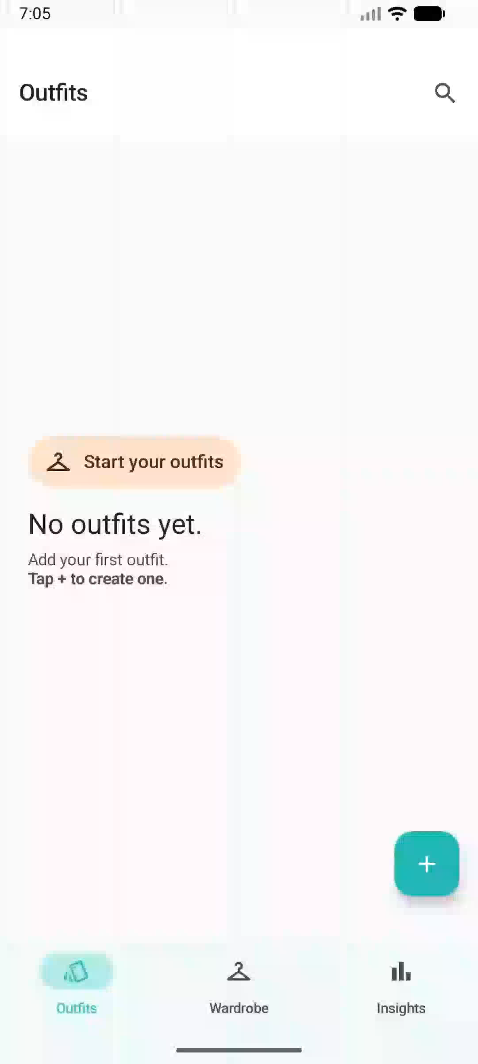

Slide 3
User Testing Outcome
Task Completion Rate (100%)
Very high SUS score (Mean: 96,3)
Very high SEQ score (Mean: 6,69)
Excellent scores overall! 🔥

Slide 4
Dolap
By DADALI Mahmut, FURRER Sarah

